Slide 1
CSCI 325
Introduction to Parallel Systems and GPU Programming
Lecture 1
Parallel software and hardware organization
Dr. Talgat Turanbekuly

Slide 2
Table of contents
Hardware
Multicore Processor, Concurrency, Parallel Programming, Process, Thread
Software
Parallel Programming, Scheduling, Speedup, Amdahl’s Law, SISD, SIMD, MIMD, Pipelines
C++
Multithreading

Slide 3
Definitions
Cluster - a set of computers connected over a local area network (LAN) that functions as a single large multiprocessor.
Parallel processing program - a single program that runs on multiple processors simultaneously.
Job level parallelism - utilizing multiple processors by running independent programs simultaneously.
Multiprocessor - a computer system with at least two processors.
Multicore, Multiprocessor - a microprocessor containing multiple processors (“cores”) in a single integrated circuit.

Slide 4

HARDWARE
https://c4.wallpaperflare.com/wallpaper/188/76/864/amd-nvidia-intel-asus-wallpaper-preview.jpg

Slide 5
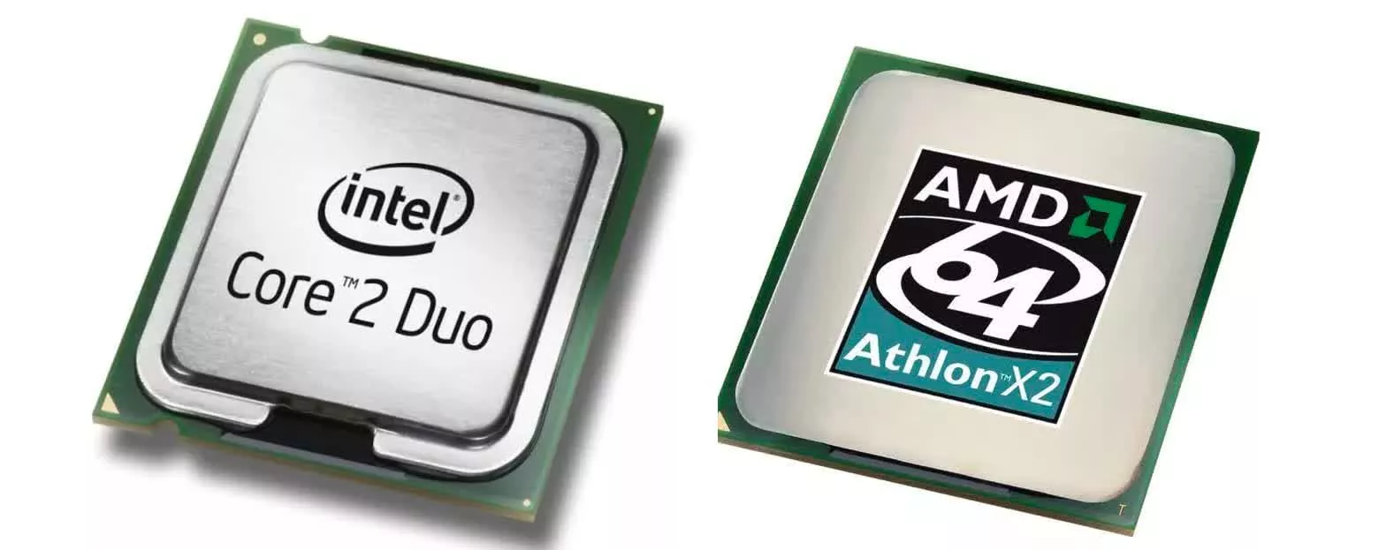
Multicore Processor
“Multiprocessor - a computer system with at least two processors.”
Patterson, David A, and John L Hennessy. Computer Organization and Design: The Hardware/Software Interface. 4th ed. San Diego: Elsevier Science & Technology, 2011. Print.
https://www.techspot.com/article/2363-multi-core-cpu/

Slide 6
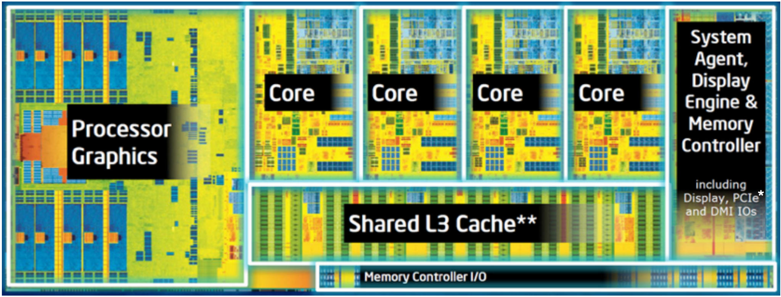
Multicore Processor
“Multicore, Multiprocessor - a microprocessor containing multiple processors (“cores”) in a single integrated circuit.”
Patterson, David A, and John L Hennessy. Computer Organization and Design: The Hardware/Software Interface. 4th ed. San Diego: Elsevier Science & Technology, 2011. Print.
https://www.intel.com/content/dam/www/public/us/en/documents/white-papers/ia-introduction-basics-paper.pdf

Slide 7

Concurrency
https://i.pcmag.com/imagery/articles/07byLBF5UaGsFsKtyOsENAg-16..v1643148022.png

Slide 8
Concurrency
CPU
TASK 1
TASK 2
TASK 1

Slide 9
Concurrency
core 1
TASK 1
TASK 3
TASK 2
CPU
core 2
TASK 2
TASK 1
TASK 3

Slide 10
Parallel Programming
“Job level parallelism - utilizing multiple processors by running independent programs simultaneously.”
core 1
TASK 1
CPU
core 2
TASK 2
Patterson, David A, and John L Hennessy. Computer Organization and Design: The Hardware/Software Interface. 4th ed. San Diego: Elsevier Science & Technology, 2011. Print.

Slide 11

Process, Thread
Process - running program with its own space.
Thread - a sequence of executable instructions within a process.
In the screenshot above, 47 threads are assigned for process named “Google Chrome”.

Slide 12
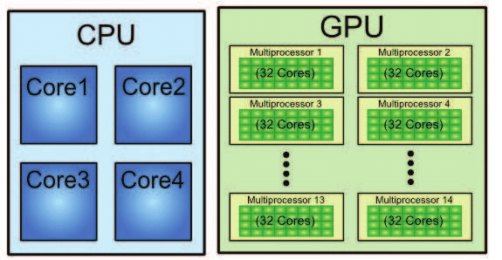
Multicore GPU architecture
https://www.researchgate.net/publication/319468789_Mobile_devices'_GPUs_in_cloth_dynamics_simulation

Slide 13

SOFTWARE
https://getwallpapers.com/wallpaper/full/c/5/d/688482-large-software-wallpapers-1920x1080-hd-1080p.jpg

Slide 14
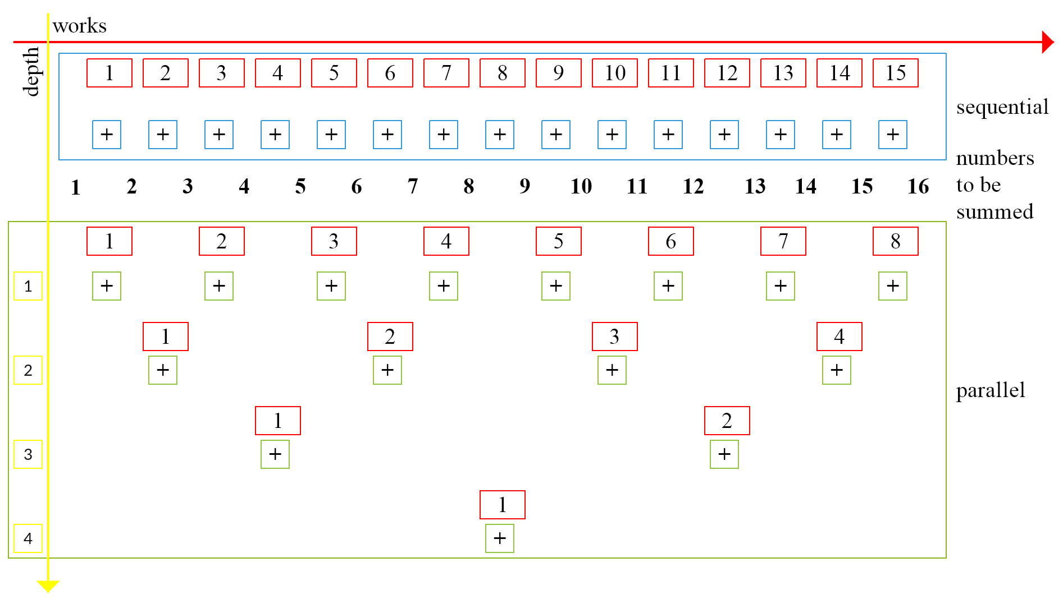
Parallel Programming Work and Span (Depth)

Slide 15
Multiprocessor Scheduling, Parallel Speedup
T1
finish
async
T2
T3
T4

Slide 16
Multiprocessor Scheduling, Parallel Speedup
T1
10
T2
finish
async
T2
FORK
JOIN
PARALLEL
T3
T1
CONTINUE
T3
CONTINUE
T4
1
10
1
T4

Slide 17
Multiprocessor Scheduling, Parallel Speedup
T1
work = 1 + 10 + 10 + 1 = 22
span = 12
ideal parallelism <=
10
T2
finish
async
work
JOIN
span
T2
FORK
PARALLEL
T3
T1
CONTINUE
T3
CONTINUE
T4
1
10
1
T4
12

Slide 18
Amdahl’s Law
Q - sequential part of the program
SPEEDUP <=
1
Q

Slide 19
Amdahl’s Law
Q - sequential part of the program
SPEEDUP <=
example 1
the portion of the program that runs only sequentially - 50 % or 0.5
maximum speedup 1 / 0.5 = 2;
example 2
the portion of the program that runs only sequentially - 10 % or 0.1
maximum speedup 1 / 0.1 = 10;
1
Q

Slide 20
Shared Memory Multiprocessor
synchronization - coordination of multiple processors when operate on shared memory.
processor 1
processor 2
…
processor N
cache 1
cache 2
…
cache N
interconnection network
administration cost for N processors same as for single machine.
shared memory
I/O

Slide 21
Message Passing Multiprocessor
message passing - sending and receiving messages among processors from their private memories.
processor 1
processor 2
…
processor N
cache 1
cache 2
…
cache N
memory 1
memory 2
…
memory N
interconnection network
High communication performance, but expensive.

Slide 22
Clusters vs. Virtual Machines
Clusters - computers connected via standard network using switches and cables.
Virtual machines - operating systems run within other OS on a physical machine
administration as costly as the size;
easy to increase/decrease the size;
start/stop programs independently;
migrate running program within computers;

Slide 23
Instructions and Data
MISD
MIMD
S - SINGLE
M - MULTIPLE
I - INSTRUCTION
D - DATA
SISD
SIMD
instructions
data

Slide 24
Instructions and Data - SISD
MISD
MIMD
instructions
SISD
SIMD
data
common personal computers with one instruction per one stream of data;
limited performance by processor;
optimization using concurrency and pipeline;

Slide 25
Instructions and Data - SIMD
MISD
MIMD
instructions
SISD
SIMD
data
the same instruction (portion of the program) run on multiple data;
multiple data must be identically structured (arrays);
each instruction execution unit has its unique address register;

Slide 26
Instructions and Data - MIMD
MISD
MIMD
instructions
SISD
SIMD
data
separate instructions run on different processors;
different processors work on different parts of a program;

Slide 27




Pipeline (example with laundry)
Put dirty clothes to the laundry
Put washed clothes to the dryer
Fold dried clothes
Put clothes away

Slide 28
Pipeline (example with laundry)
TIME

Slide 29
Pipeline (example with laundry)
TIME
1 2 3 4
work = 4 x 4;
CPL = 4 + (4 - 1);
Parallelism = (4x4)/(4+4-1) ≈ 2.3;
work = N x P;
CPL = N + (P - 1);
Parallelism =
(N*P) / (N + P - 1)
stage 1
stage 2
stage 3
stage 4
N - work in each stage;
P - pipeline stages;
CPL - critical path length;

Slide 30
Pipeline (example with laundry)
1 2 3 4
Increases the number of simultaneously executing instructions;
Does not reduce the time to complete individual instructions;
TIME

Slide 31
C++ Multithreading
Examples

Slide 32
Summary
Parallel programming not always faster
Acceleration requires hardware and effectively developed software
There are lots of techniques for parallelization and software optimization
There are existing frameworks and libraries for parallel programming

Slide 33
Resources
https://www.intel.com/pressroom/archive/releases/2005/20050418comp.htm
Computer Organization and Design - The Hardware/Software Interface 4th Edition (Ch. 7) by Patterson, David A, and John L Hennessy. San Diego: Elsevier, 2009. Print.
Computer Architecture: A Quantitative Approach 5th Edition (Ch. 3 and Ch. 4) by John L. Hennessy and David A. Patterson, MK Publications.
Kalin, Martin. Concurrent and Parallel Programming Concepts. online O’Reilly, 2015. Print.
Harvey Deitel, and Paul J. Deitel. C++20 for Programmers: An Object's-Natural Approach, 3rd Edition, 2022;
Paul J. Deitel. C++20 Fundamentals, 3rd Edition. 2024;
Anthony Williams. C++ Concurrency in Action, Second Edition, 2019;
Bartosz Milewski, Introduction to C++ Concurrency LiveLessons (Video Training), 2014
https://dl.acm.org/doi/pdf/10.1145/1465482.1465560
https://www.geeksforgeeks.org/computer-organization-amdahls-law-and-its-proof/amp/
https://dl.acm.org/doi/pdf/10.1145/227234.227246
https://docs.oracle.com/javase/8/docs/api/java/util/stream/Stream.html

